Slide 1

THE “PORTFOLIO EFFECT” IN PHARMACEUTICAL PRICE REGULATION
Tatiana Andia
Sociology Professor at Universidad de los Andes
Coordinator of ‘Salud Visible’

Slide 2
OUTLINE
The promise of pharmaceutical regulation
Cautions included in the literature
But… what if we changed the unit of analysis?
Why looking at portfolios?
What we did in this technical note (method)
What we learned by doing it (lessons)
What needs to be done (recommendations)

Slide 3

I.
THE PROMISE OF PHARMACEUTICAL PRICE REGULATION
(IRPs in particular)

Slide 4
THE PROMISE OF SAVINGS
863
42%
REGULATED DRUGS
PRICE REDUCTION
$200
MILLION USD
ESTIMATED SAVINGS

Slide 5


THE PROMISE OF SELF REGULATION
YOU ARE BEING WATCHED
REPUTATION

Slide 6

In general, the literature does suggest that the prices of regulated products decrease thanks to IRPs.
(Windmeijer, De Laat, Douven, & Mot, 2006; Filko & Szilagyiova, 2009; Håkonsen, Horn, & Toverud, 2009 Leopold, Mantel-Teeuwisse, et al., 2012)

Slide 7
II.
EXERCIZE CAUTION AS SUGGESTED IN THE LITERATURE

Slide 8

THE R&D EFFECT
· Price regulation may lead to a decrease in R&D investment via an expected-profit effect and/or a cash-flow effect.

Slide 9
THE R&D EFFECT
· Price regulation may lead to a decrease in R&D investment via an expected-profit effect and/or a cash-flow effect.
(Vernon 2004)
THE LAUNCHING EFFECT
· Price regulation may lead to higher launching prices
(Abott 1995)
· Price regulation could affect decisions about in which country to launch first
(Danzon et al. 2005)

Slide 10
THE R&D EFFECT
· Price regulation may lead to a decrease in R&D investment via an expected-profit effect and/or a cash-flow effect.
(Vernon 2004)
THE LAUNCHING EFFECT
· Price regulation may lead to higher launching prices.
(Abott 1995)
· Price regulation could affect decisions about in which country to launch first.
(Danzon et al. 2005)
THE INTERDEPENDENCY EFFECT
· Mutual referencing may lead to price convergence.
(Kanavos, Nicod, Espin, & Van Den Aardweg, 2010 )

Slide 11
In Colombia, the evidence shows that:
. Prices of regulated products decreased (between 31% and 57%).
. But, total pharmaceutical sales increased at an annual rate of 26%.
(Prada et al. 2018)

Slide 12
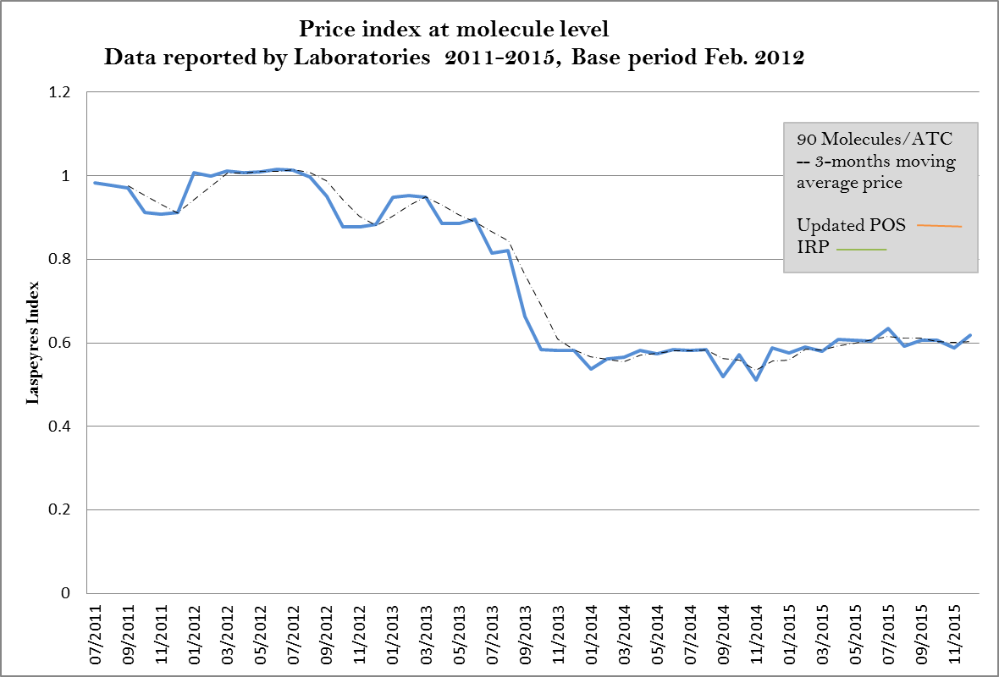
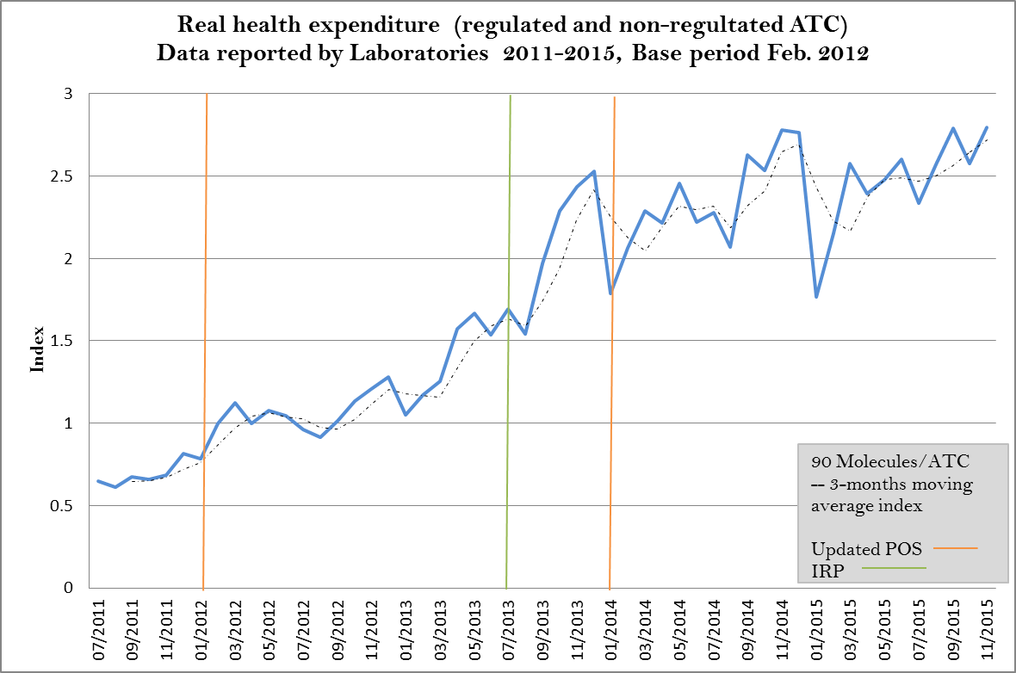
PRICE OF REGULATED PRODUCTS DECREASE
TOTAL PHARMACEUTICAL EXPENDITURE INCREASES

Slide 13
III.
WHAT IF WE CHANGED THE
UNIT OF ANALYSIS

Slide 14
HOW WE USUALLY EXPLAIN THE INCREASE IN PHARMACEUTICAL EXPENDITURE
Policy :
1. Incomplete or irregular pharmaceutical price regulation
2. New medicines are included in the benefits package
Market (and marketing):
3. New technologies are entering the market (technological pressure)
4. Lower prices increase access and therefore quantities sold
5. Induced demand
Health:
6. Epidemiological changes could increase consumption of certain products

Slide 15

LET´S LOOK AT COMPANIES
Rather tan looking at
PRODUCTS or
THERAPEUTIC GROUPS or
TOTAL EXPENDITURE
Isn´t at that level that pricing decisions are made?

Slide 16
IV.
WHY LOOKING AT
PORTFOLIOS

Slide 17
It may be provide a different understanding of how are pricing and marketing decisions being made
1. It could help us see changes in and identify patterns of prices and quantities of regulated within a single company.
2. It could help us see changes in and identify patterns of prices and quantities of unregulated products within a single company.

Slide 18
V.
WHAT WE DID AND DID NOT DO

Slide 19
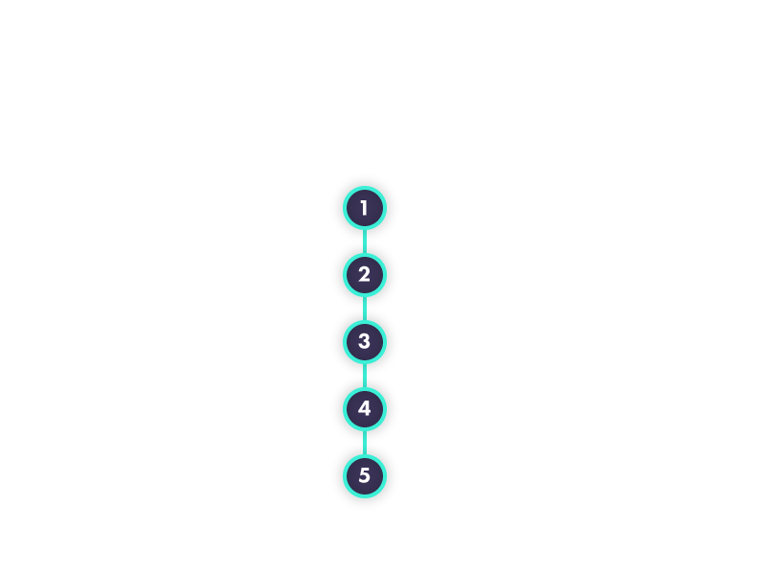
METHOD
Selected five portfolios
. High impact
. Diverse type
Constructed price and quantity indexes
. Regulated versus not-regulated
. Product that increased prices versus those that decreased
Analyzed the timing of price and quantities changes as well as total sales
(descriptive)
Analyzed the probable causes
(to be further analyzed using econometrics)
Suggested avenues for future research
Suggested policy implications

Slide 20
VI.
WHAT WE
LEARNED

Slide 21
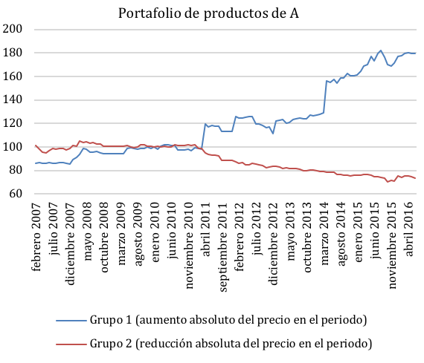
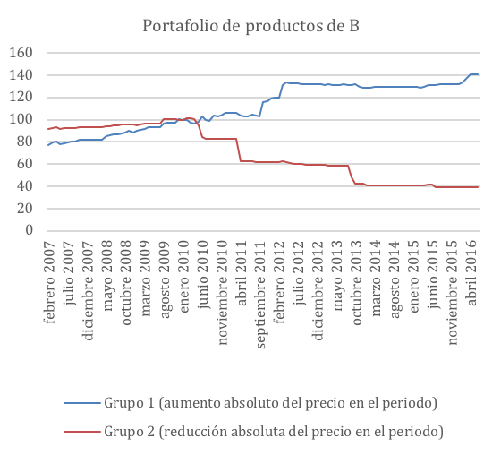
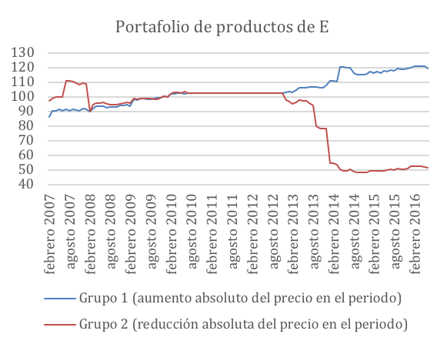
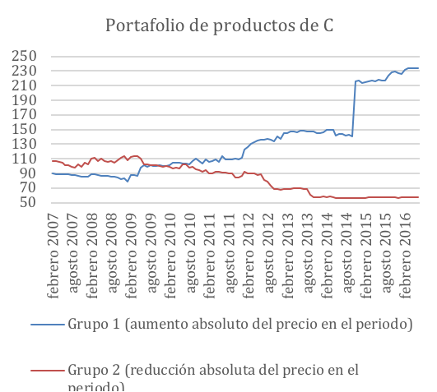
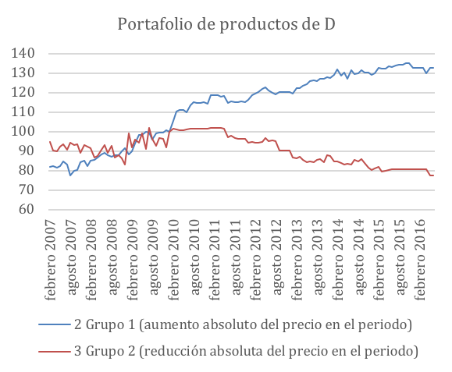
WHEN SOME PRICES GO DOWN OTHERS GO UP

Slide 22
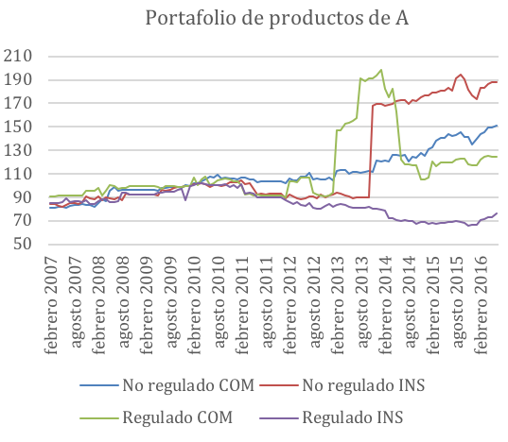
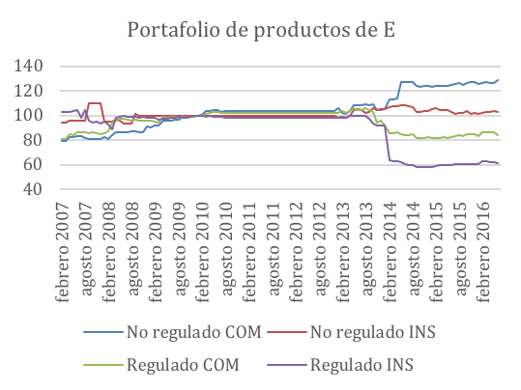
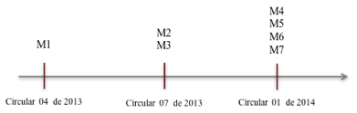
PRICES OF UNREGULATED PRODUCTS INCREASE
(red and blue lines)

Slide 23
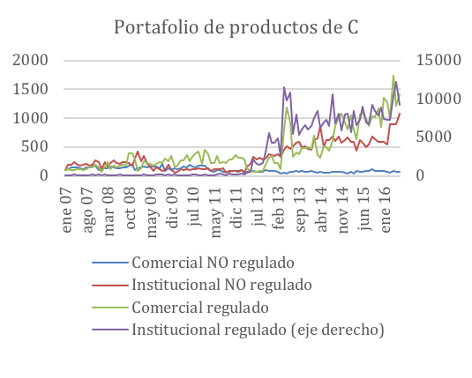
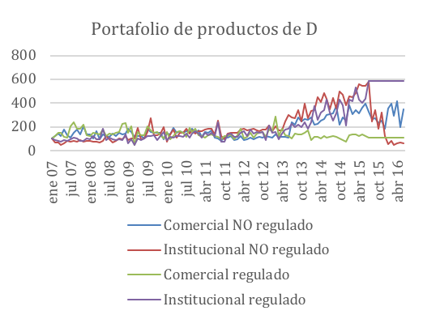
QUANTITIES OF REGULATED PRODUCTS INCREASE
(green and purple lines)

Slide 24
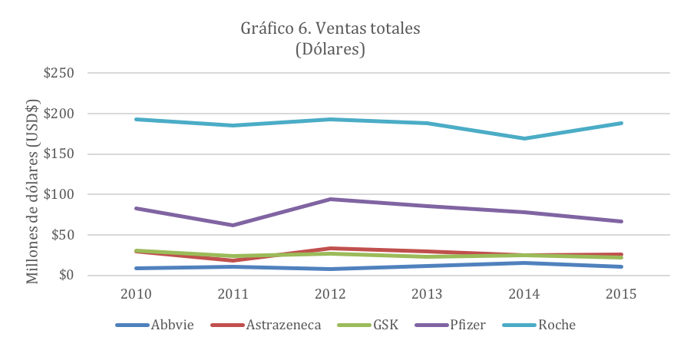
TOTAL SALES DECREASE (but slightly)
D
E
C
A
B

Slide 25
SUMMARY OF EFFECTS
Company | No. Regulated products | First IRP | Products with greatest Price increase | Products with greates quantity increase | Average monthly effect on sales (current) | Total sales change (base=2015)
A | 7 | 2013 | No regulados (institucional) | Regulados (institucional) | + | - 20%
B | 8 | 2013 | No regulados (institucional) | Regulados (institucional) | + | -3%
C | 3 | 2013 | No regulados (comercial) | Regulados (institucional) | - | -12%
D | 3 | 2013 | No regulados (comercial) | Regulados (institucional) | + | +17%
E | 7 | 2013 | No regulados (comercial) | Regulados (institucional) | + | -12%

Slide 26

VII.
WHAT NEEDS TO BE
DONE

Slide 27

EXPAND THE REGULATORY TOOLKIT

Slide 28
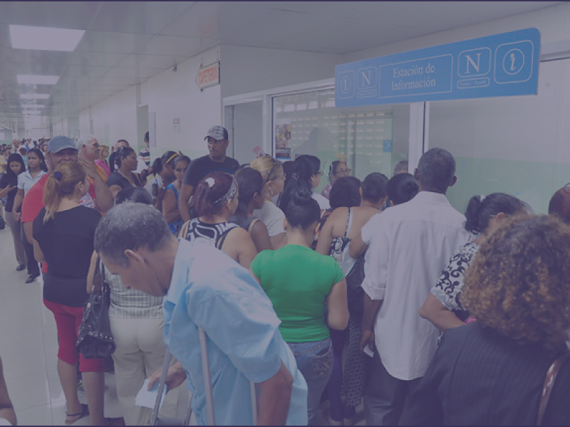
LINK COVERAGE AND PHARMACEUTICAL POLICIES

Slide 29

MONITOR PRICE AND QUANTITY INCREASES

Slide 30

CULTURAL CHANGE AND RATIONAL USE OF MEDICINES

Slide 31

STUDY FAR MORE
Conduct econometric analysis to assess causality
Specific product effects and their importance for public health
Compare across more companies

Slide 32
THINK OF PHARMACEUTICAL EXPENDITURE AS A BALOON
(Contiades et al. 2007)

